Slide 1

AGILE METHOD
-By K. Eesha Apoorva

Slide 2
Introduction
Agile model is a combination of iterative and incremental process models with focus on process adaptability and customer satisfaction by rapid delivery of working software product.
Agile Methods break the product into small incremental builds.
These builds are provided in iterations.
At the end of the iteration, a working product is displayed to the customer and important stakeholders.

Slide 3
Roles of Agile Model
1. Team lead:
This role, also called as "Scrum Master".
It is responsible for facilitating the team, obtaining resources for it, and protecting it from problems.
2. Team member:
This role, sometimes referred to as developer or programmer.
It is responsible for the creation and delivery of a system.

Slide 4
3. Product owner:
The product owner, called on-site customer in XP and active stakeholder in AM, represents the stakeholders.
This is the one person who owns the product..
4. Stakeholder:
He is the "gold owner" who funds the project.

Slide 5
Advantages of Agile model
Is a very realistic approach to software development.
Promotes teamwork and cross training.
Functionality can be developed rapidly and demonstrated.
Resource requirements are minimum.
Suitable for fixed or changing requirements
Delivers early partial working solutions.
Good model for environments that change steadily.
Minimal rules, documentation easily employed.

Slide 6
Disadvantages of Agile model
Not suitable for handling complex dependencies.
More risk of sustainability, maintainability and extensibility.
An overall plan, an agile leader and agile PM practice is a must without which it will not work.
Strict delivery management dictates the scope, functionality to be delivered, and adjustments to meet the deadlines.
Depends heavily on customer interaction, so if customer is not clear, team can be driven in the wrong direction.

Slide 7
12 Principles of Agile Model
Satisfying the customer
Welcome changing requirements
Deliver working software frequently
Business works with developers daily
Build projects around motivated individuals

Slide 8
Face-to-face conversations best
Working software matters
Constant pace
High quality code is fast
Maximize work not done
Self organizing team delivery quality
Feedback loops used to improve

Slide 9
Characteristics of Agile Model
Characteristics
of
Agile method
Iteration
Adaptation
Time bound
Modular functioning
People Oriented
Incremental

Slide 10

Scrum
SCRUM is an agile development process focused primarily on ways to manage tasks in team-based development conditions.
The Agile Scrum Methodology is focused on improving teamwork through continuous learning using iterations.
Scrum was mainly used by software development teams but has now grown to be accepted within other industries as well.

Slide 11
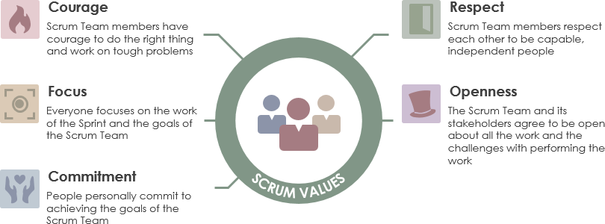

Slide 12
Principles of Scrum
Rapid feedback
Assure Simplicity
Incremental charge
Embracing charge
Quality work

Slide 13

Kanban
Kanban is a popular Lean workflow management method for defining, managing, and improving services that deliver knowledge work.
It helps you visualize work, maximize efficiency, and improve continuously.
Work is represented on Kanban boards, allowing you to optimize work delivery across multiple teams and handle even the most complex projects in a single environment.

Slide 14
Principles of Kanban
Start with what you are doing now
01
Agree to pursue incremental, evolutionary change
02
Initially, respect current roles, responsibilities and job-titles
03
Encourage acts of leadership at all levels
04

Slide 15
Practices of Kanban method
Visualize
Visualize the flow of work
Limit
Limit WIP (Work in Progress)
Manage
Manage Flow
Make
Make Process Policies Explicit
Implement
Implement Feedback Loops
Improve
Improve Collaboratively, Evolve Experimentally

Slide 16
Thank you

